Slide 1


Department of BES-1
DATA STRUTURES
24SC1203
Topic:
HEAP SORT
Session -31

Slide 2



AIM OF THE SESSION
To familiarize students with the basic concept of heap sort and its implementation
INSTRUCTIONAL OBJECTIVES
This Session is designed to:
DEMONSTRATE THE HEAP SORT
DESCRIBE THE HEAPIFYING
LIST OUT THE TYPES OF HEAPIFYING
LEARNING OUTCOMES
At the end of this session, you should be able to:
DEFINE MAX HEAP AND MIN HEAP
DESCRIBE HEAPIFYING
SUMMARIZE

Slide 3
Agenda
Introduction to Heap Sort
Heap Data Structure
Algorithm Explanation
Time and Space Complexity
Advantages and Disadvantages
Real-World Applications
Summary

Slide 4
INTRODUCTION TO HEAP SORT
Definition: Heap Sort is a comparison-based sorting technique based on a Binary Heap data structure.
Key Idea:
  Convert the array into a max-heap.
  Repeatedly extract the largest element (root) and rebuild the heap.
Sorting Type: In-place and non-stable sorting algorithm.

Slide 5
Binary Heap Basics
Definition: A binary heap is a complete binary tree satisfying:
Max-Heap Property: Parent nodes are greater than or equal to their children.
Min-Heap Property: Parent nodes are less than or equal to their children.
Representation: Usually implemented using arrays.

Slide 6
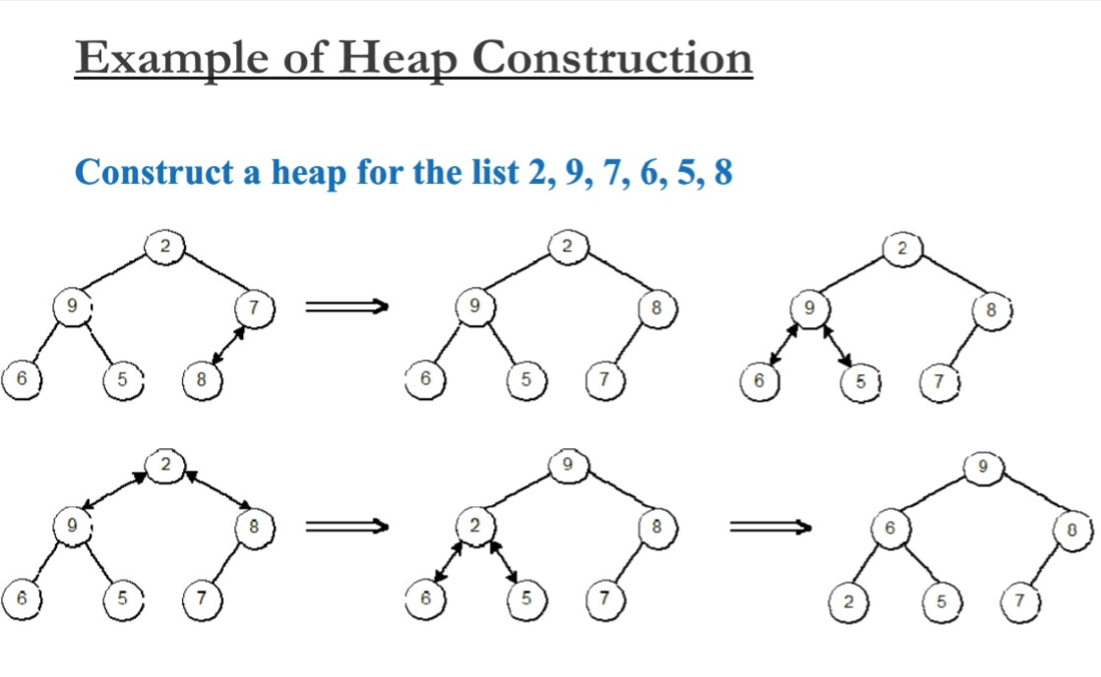
Heap Construction Algorithm
Step 1: Create a new node at the end of heap.
Step 2: Assign new value to the node.
Step 3: Compare the value of this child node with its parent
Step 4: If value of parent is less than child, then swap them
Step 5: Repeat step 3 & 4 until Heap property holds.

Slide 7
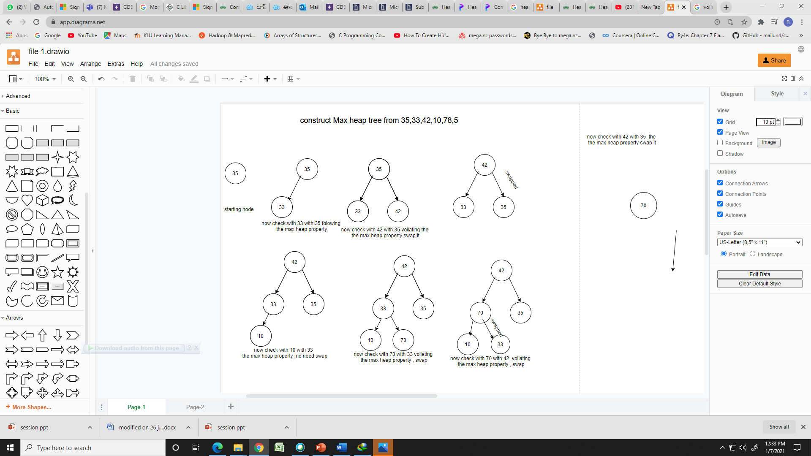
Construction of max heap tree

Slide 8
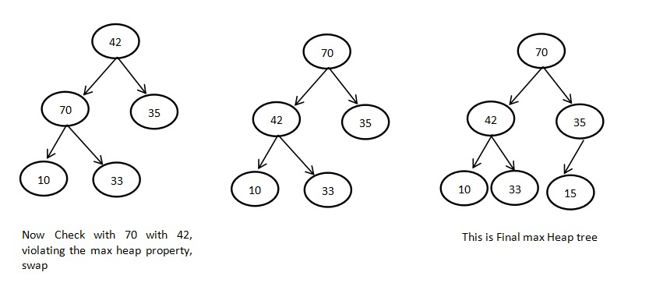
Construction of max heap tree(Cont..)

Slide 9
Heap Sort Algorithm for sorting in decreasing order
1. Build a max heap from the input data.
2. At this point, the largest item is stored at the root of the heap. Replace it with the last item of the heap followed by reducing the size of heap by 1. Finally, heapify the root of the tree.
3. Repeat step 2 while size of heap is greater than 1.

Slide 10
Heap Sort Algorithm for sorting in increasing order
1. Build a min heap from the input data.
2. At this point, the smallest item is stored at the root of the heap. Replace it with the last item of the heap followed by reducing the size of heap by 1. Finally, heapify the root of the tree.
3. Repeat step 2 while size of heap is greater than 1.

Slide 11
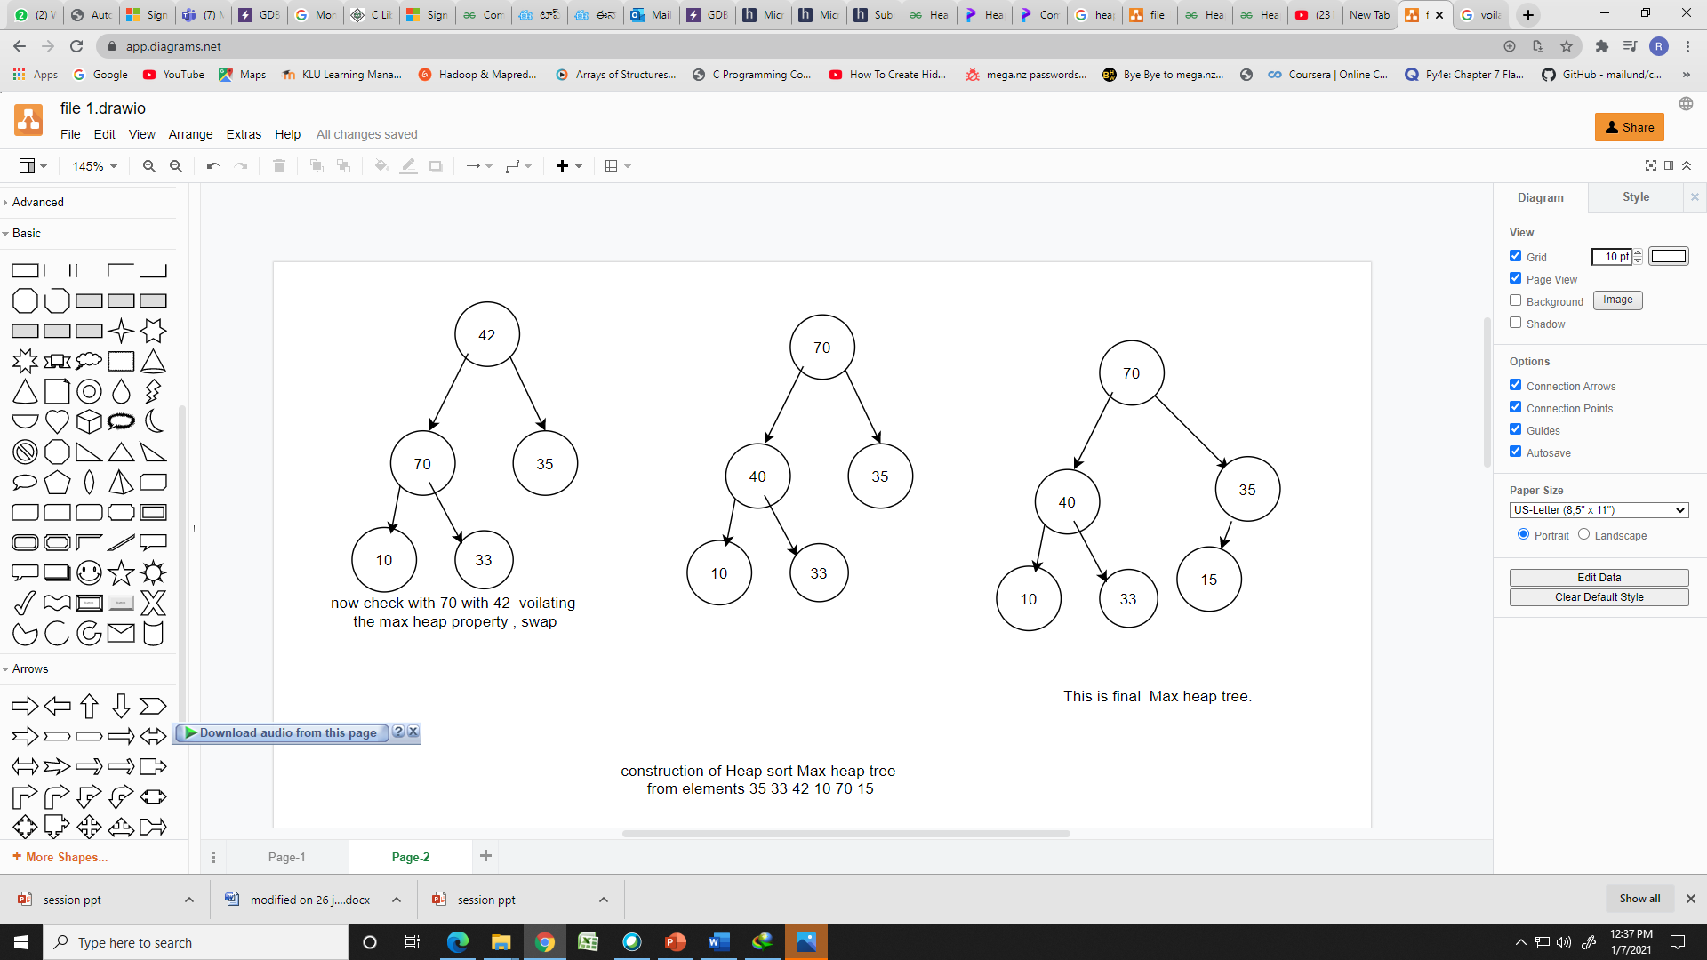
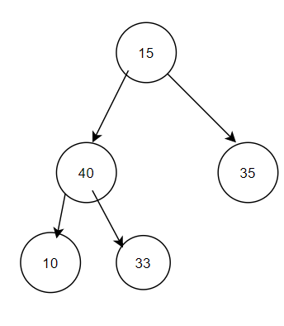
Max heap(Cont..)
We start from A, and followi
Remove the root element (70)and replace with last leaf node(15). That removing element store in Array a[]

Slide 12
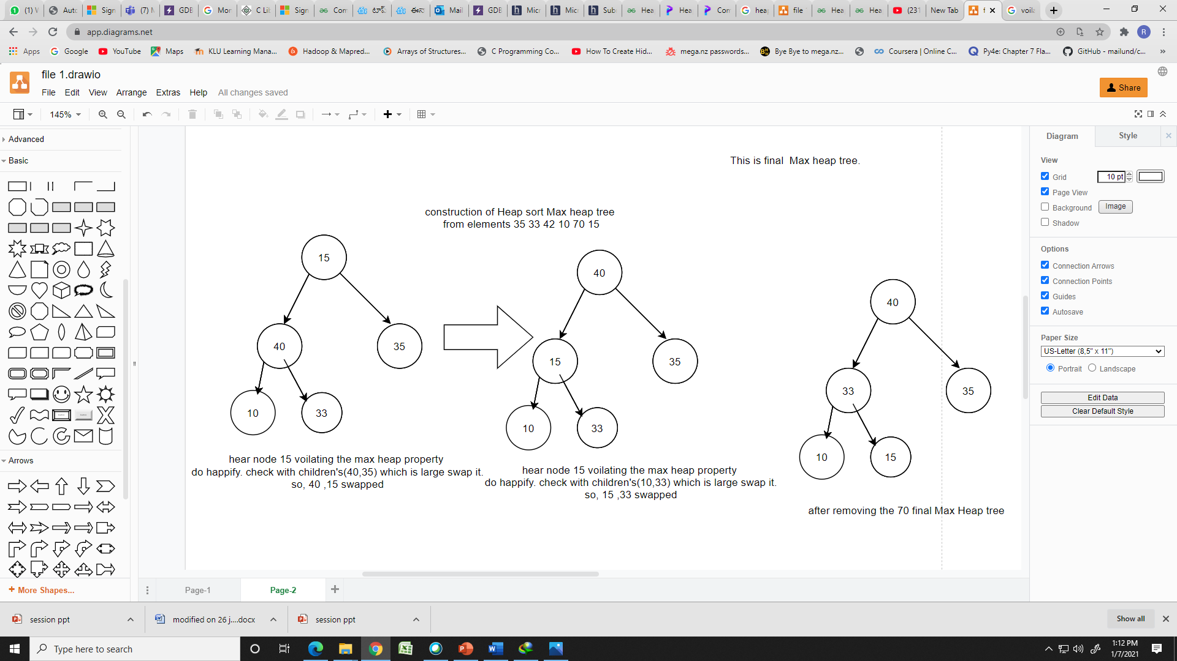
Max heap(Cont..)
A[ ]
70

Slide 13
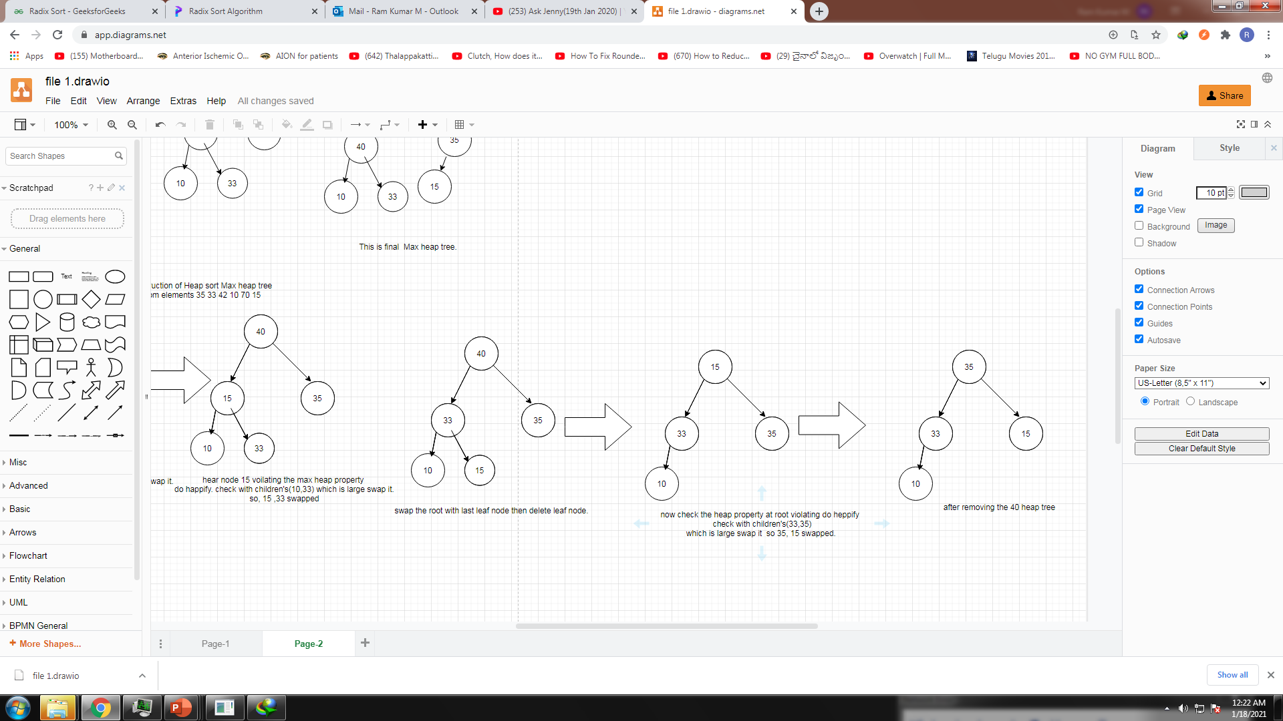
Max heap (Cont..)
A[ ]
70 | 40

Slide 14
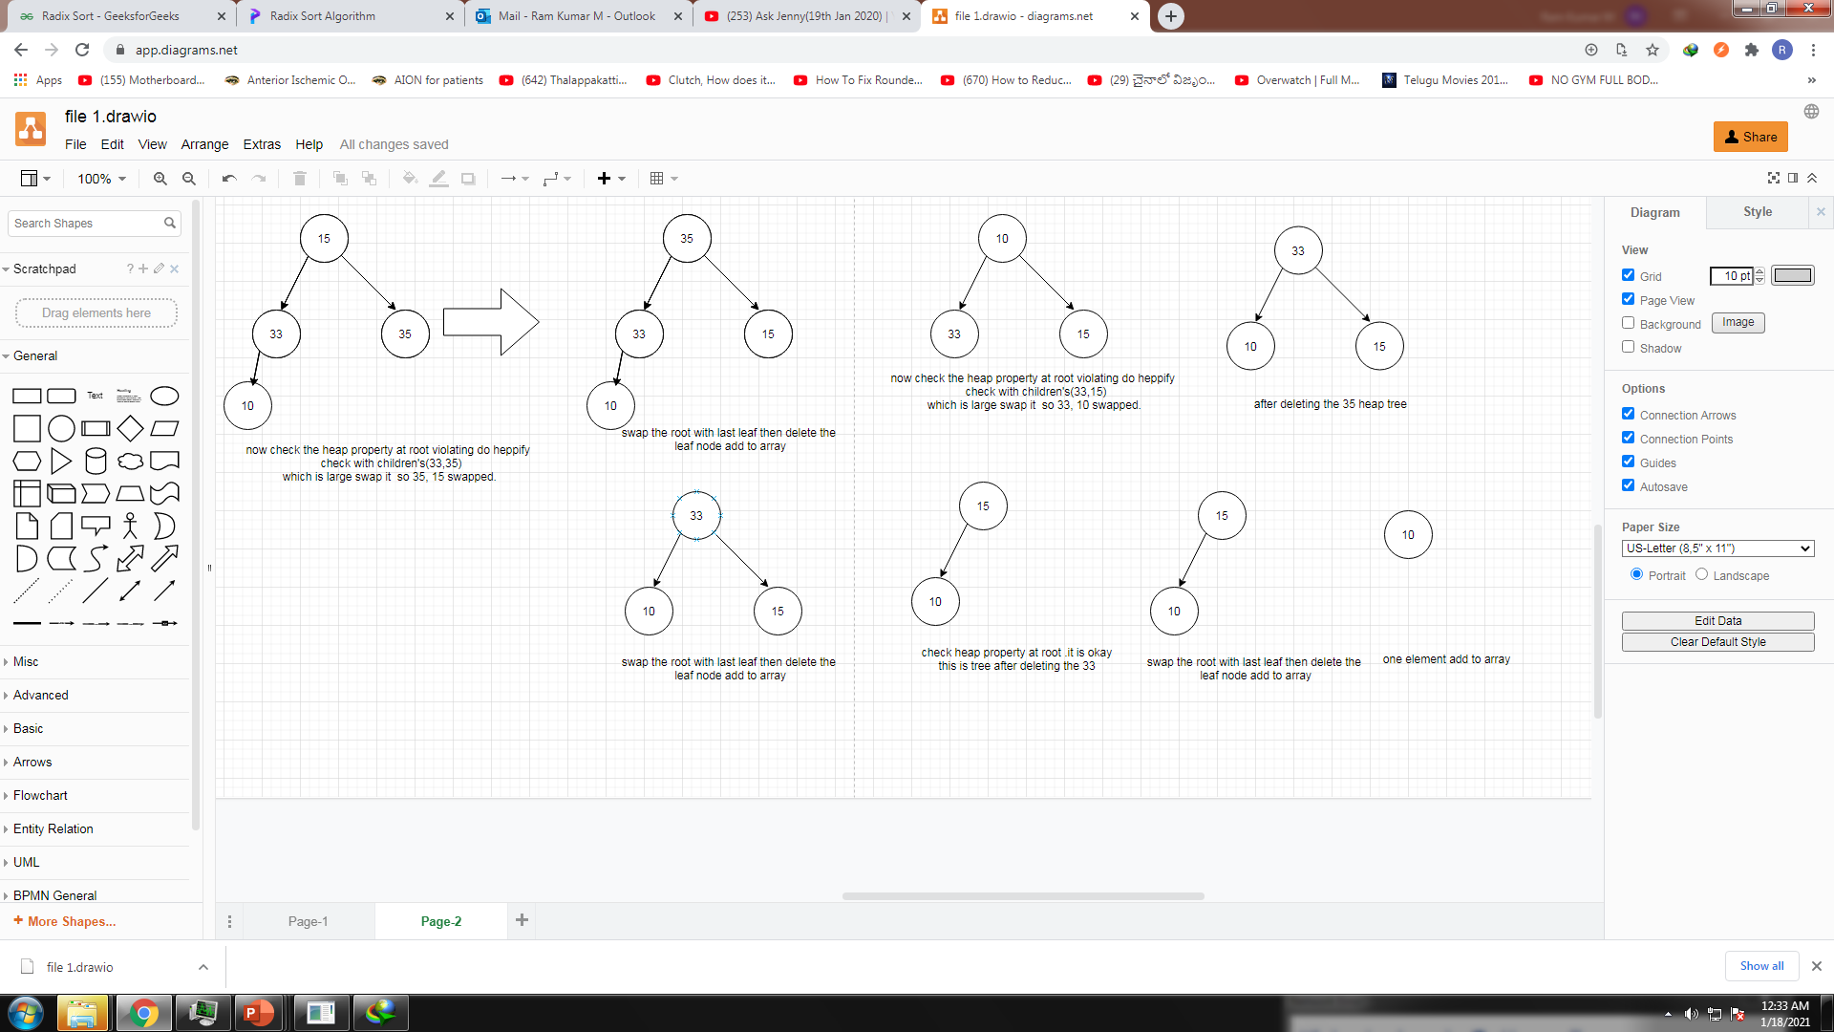
BINARY TREE (Cont..)
A[ ]
A[ ]
70 | 40 | 35 | 33 | 15 | 10
Final sorted array

Slide 15
Time Complexity
Building the Heap: O(n)
Heapify Operation: O(log n) per element
Total Sorting: O(n log n)
Space complexity: O(1) (in-place sorting)

Slide 16
Advantages and Disadvantages
Advantages:
Efficient for large data sets.
In-place sorting (requires no extra memory).
Disadvantages:
Not a stable sort.
Requires additional computation for heap maintenance.

Slide 17
SUMMARY
Heap Sort uses a binary heap to sort efficiently
Time Complexity: O(n log n)
Useful for in-place sorting without extra memory overhead

Slide 18
SELF-ASSESSMENT QUESTIONS
On which algorithm is heap sort based on?
Fibonacci heap
Binary tree
Priority queue
FIFO
2. Consider the following array of elements.
(89, 19, 50, 17, 12, 15, 2, 5, 7, 11, 6, 9, 100)
The minimum number of interchanges needed to convert it into a max- heap is
4
2
3
6

Slide 19
SELF-ASSESSMENT QUESTIONS
3. Consider the following statements about heap sort algorithm:
A. The MAX-HEAPIFY procedure which runs in O(log n) time, is the key to maintaining the max heap property
B. The BUILD-MAX-HEAP procedure, which runs in O(log n) time, produces max-heap from an unordered input array.
C. The MAX-HEAP-INSERT, which runs in O(n log n) time, implements the insertion operation.
D. The HEAP-INCREASE-KEY pocedure runs in O(n log n) time, to set the key of new node of its correct value.
Choose the correct answer from the options given below:
A, B only
A, C only
B, D only
A, B, C, D.

Slide 20
SELF-ASSESSMENT QUESTIONS
4. Consider a complete binary tree where the left and the right subtrees of the root are max-heaps. The lower bound for the number of operations to convert the tree to a heap is:
Ω(N)
Ω(N log N)
Ω(log N)
Ω(N2)
5.Let H be a primary min-heap consisting of n elements implemented as an array. What is the worst case time complexity of an optimal algorithm to find the maximum element in H?
θ(N)
θ(N log N)
θ(log N)
θ(1)

Slide 21
SELF-ASSESSMENT QUESTIONS
6.Given a binary-max heap. The elements are sorted in an arrays as 25, 14, 16, 13, 10, 8, 12. What is the content of the array after two delete operations?
14,13, 8, 12, 10
14, 12, 13, 10, 8
14, 13, 12, 8, 10
14, 13, 12, 10, 8
7. In heap sort, after deleting the last minimum element, the array will contain elements in?
increasing sorting order
decreasing sorting order
tree inorder
tree preorder

Slide 22
TERMINAL QUESTIONS
1. Describe heap sort and heapifying with examples
2. List out the applications of heapsort
3. Analyze the time complexity of heap sort
4. What is a binary heap, and how is it used in Heap Sort?
5. What is a binary heap, and how is it used in Heap Sort?
6. Explain the process of heapifying an array.

Slide 23
REFERENCES FOR FURTHER LEARNING OF THE SESSION
Reference Books:
1. Data structures using c By Reema Thareja
2. Data structure through c by Yashavant Kanetkar
3. Data Structure and Algorithms by Bala Guruswamy
Sites and Web links:
1. https://www.amazon.com/gp/product/0521880378/
2. https://www.amazon.in/Structures-Through-Second-Revised-Update/dp/B09FZH2KNZ/ref=sr_1_6?qid=1670557445&refinements=p_27%3AS.K.Srivastava%2FDeepali+Srivastava&s=books&sr=1-6

Slide 24
THANK YOU
Team – Course Name

